Slide 1


智冠科技 數位發展中心
Google Cloud Platform Tutorial
智冠科技

Slide 2
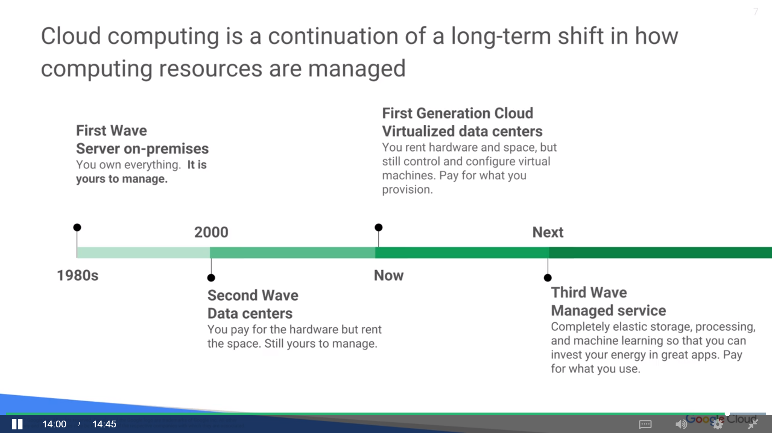

Slide 3
Server on-premise
Server on-premise
Managed Server, PC, Data, Server, Software, Electronic, Power
Controll everything, all counts on you

Slide 4
Data Center
Data Center
Managed Server, PC, Data, Server, Software, Electronic, Power
Into Data Center, in multiple region
Own the hardware, hire someone to control the security
Give up direct physical access to the machine

Slide 5
First Generation of Cloud Virtualized Data Center
Colud
Not even own the Hardware
Asking computer resources, such as VMs, to computing
Shares computer resources,
not worry the cost when you don’t use it

Slide 6
Google Cloud Platform
Third Wave Managed Service
Organize world’s information in multiple region for universal access
Data Center everywhere
Pay for the Service, not the compute note when u only need storage
Pay for the only 10s for using million computing notes.

Slide 7
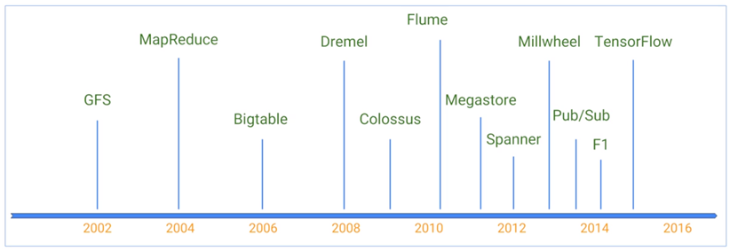
Google Cloud Platform
Third Wave Managed Service

Slide 8
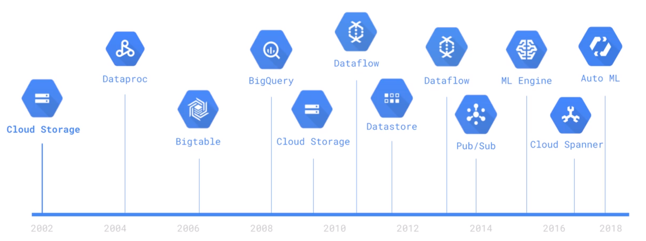
Google Cloud Platform
Third Wave Managed Service

Slide 9
Google Cloud Platform
Third Wave Managed Service
Hadoop, 2004, is not recommended now,
since the MapReduce tends to limited by the number of computer
notes you have
The Cloud is hugely beneficial,
if you are running things ephemerally.
If you're running things just when you need them

Slide 10
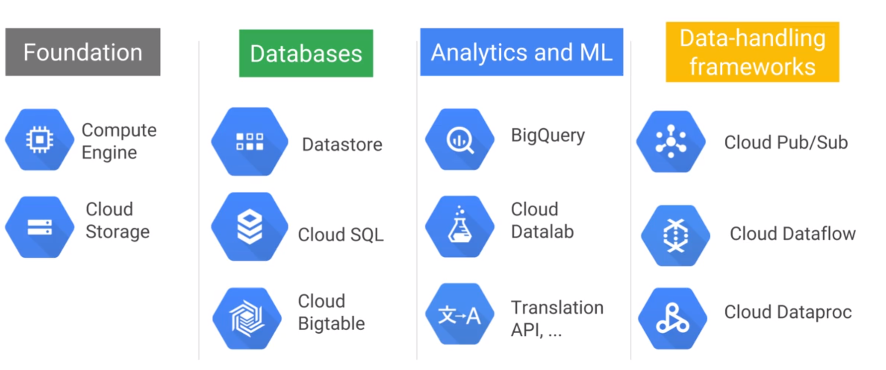
Google Cloud Platform
Third Wave Managed Service
Computing Service
completely serverless,
fully managed data warehouse
Staging Data
RDB,G, GCE, GAE
Hadoop, hive, pig, spark
HDFS, cluster need to be UP
json,P, Key-Value

Slide 11
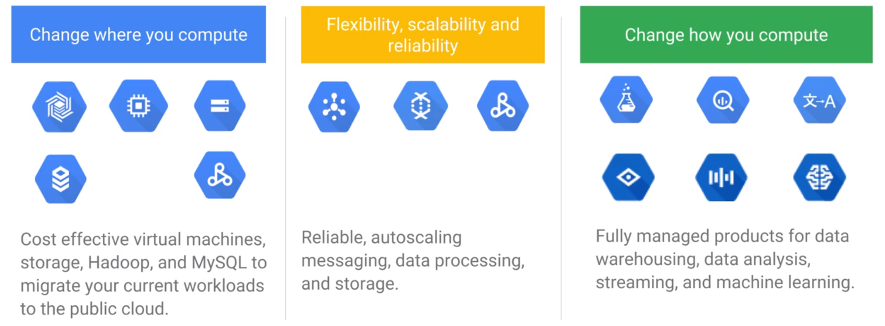
Google Cloud Platform
Third Wave Managed Service
Cheaper, Safer

Slide 12
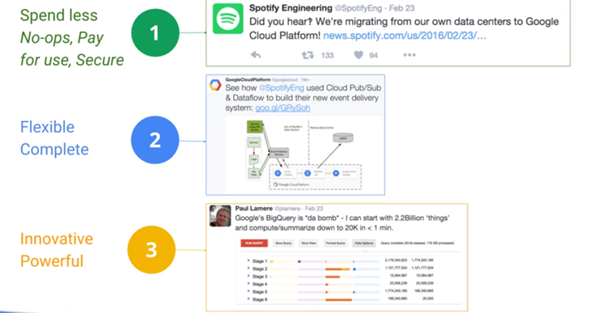
Google Cloud Platform, no systems operation required
Third Wave Managed Service

Slide 13
GCP, earth-scale computer, no systems operation required
Third Wave Managed Service
CPU+ Net Working = computing + storage
Working with cloud infrastructure to be as no-ops as possible
Preemptible Virtual Machine：discount~discount~discount

Slide 14
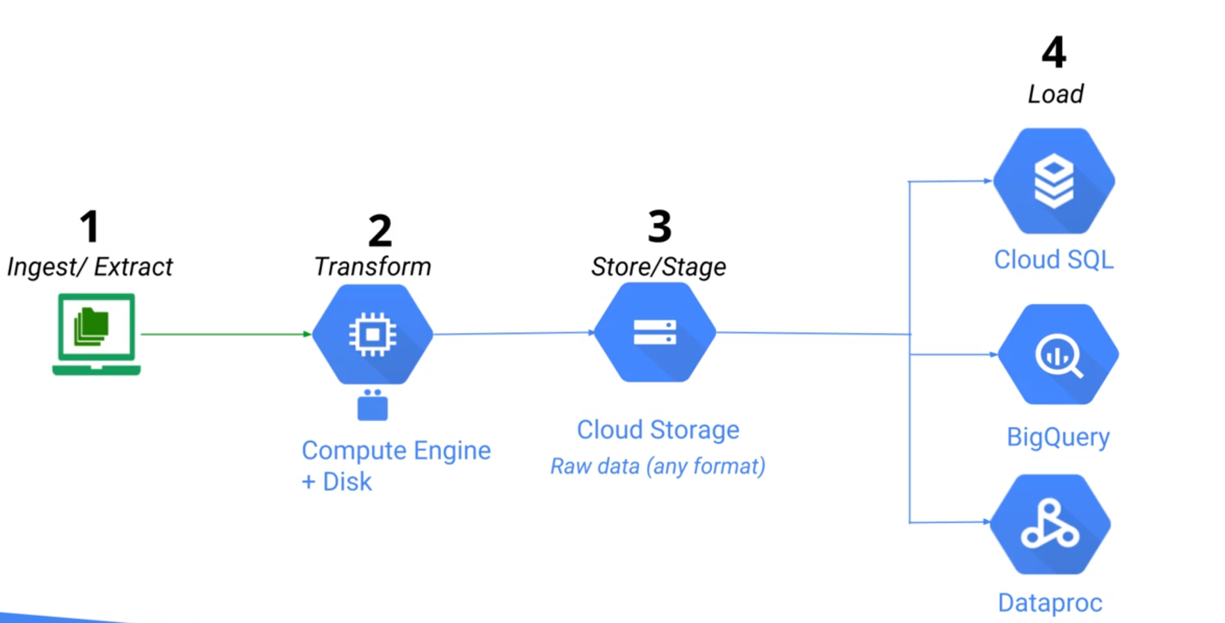
GCP, Step 1, upload data to Storage
Third Wave Managed Service

Slide 15
GCP, Step 1, upload data to Storage
Third Wave Managed Service
Disks are associated with the compute engine that they're attached to.
When the compute engine goes away, the disk also goes away.
GCP, not store it on a disk, store it on cloud storage

Slide 16
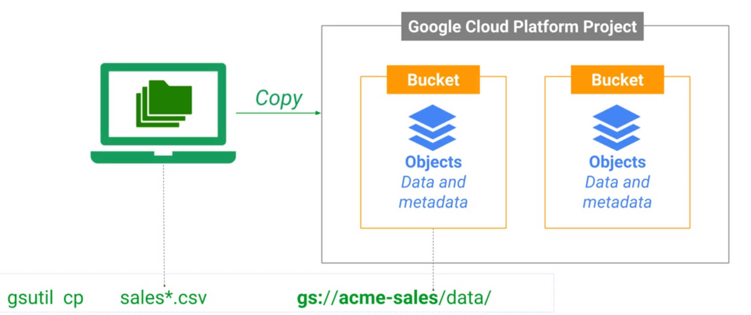
GCP, Step 1, upload data to Storage
Third Wave Managed Service

Slide 17
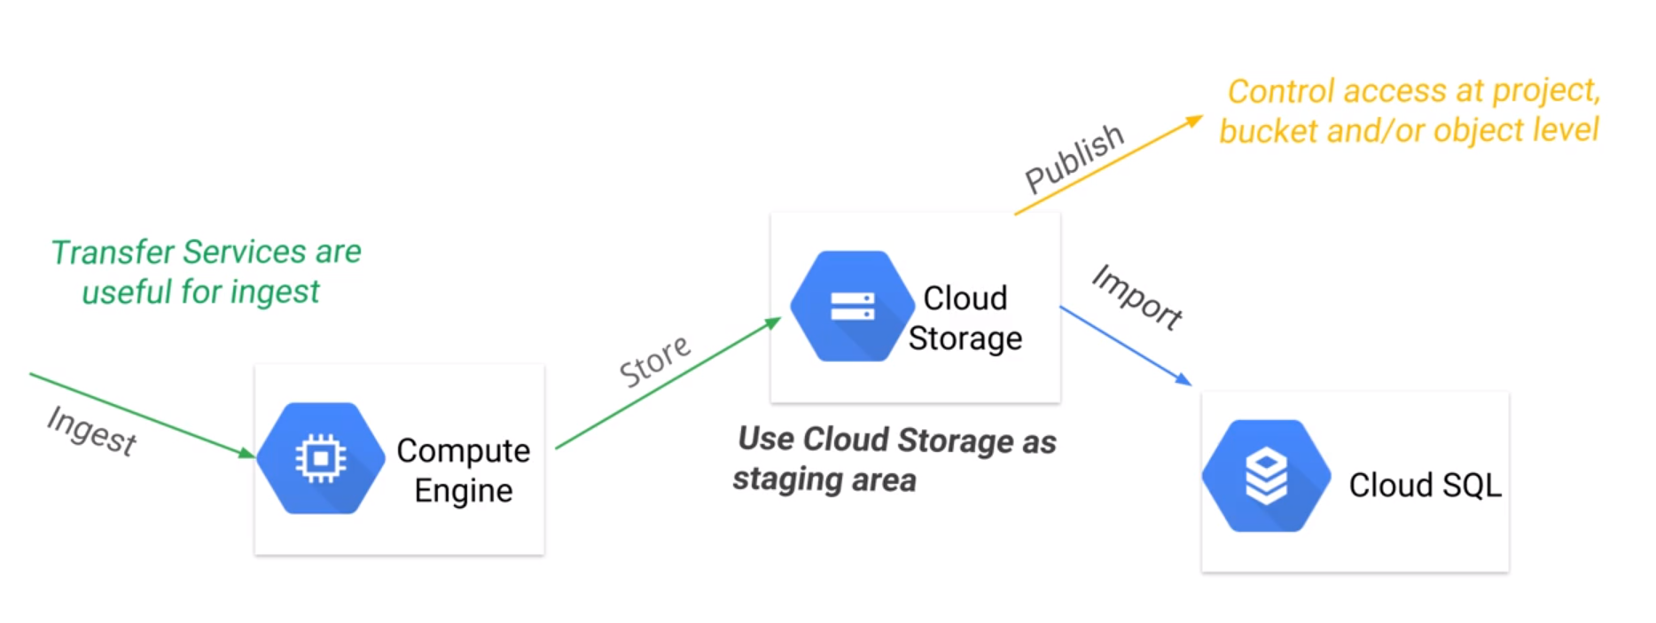
GCP, Step 1, upload data to Storage
Third Wave Managed Service

Slide 18
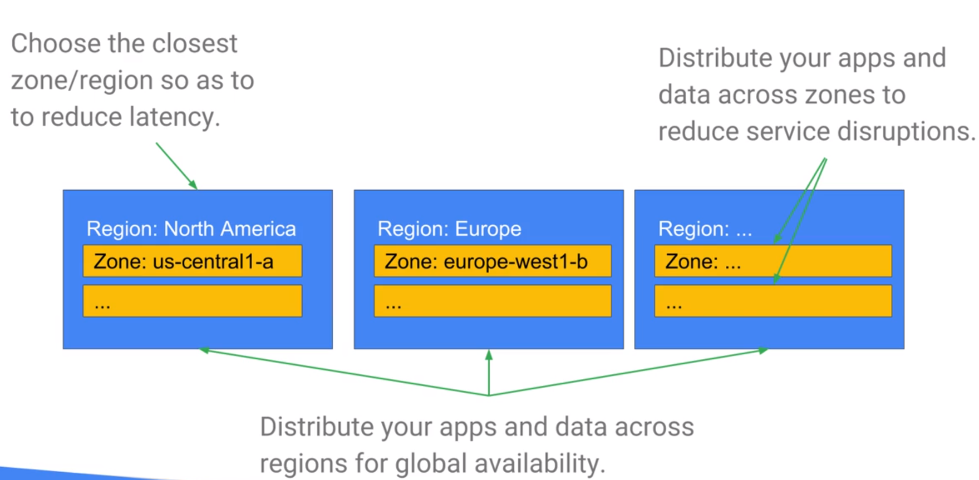
GCP, Step 1, upload data to Storage
Third Wave Managed Service
Multiple zone in Multiple Region which is closest to u
reduce latency
reduce service disruptions

Slide 19
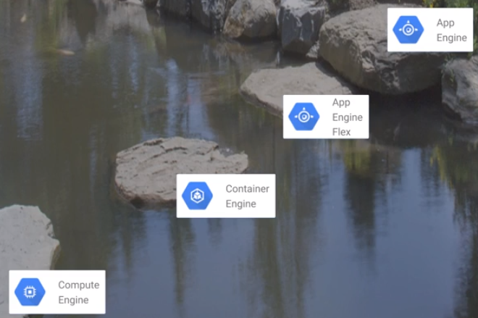
GCP, wrong step
Third Wave Managed Service
Ask customer use it like everyone else,
need java (java only) skill
google fix everything
On premium, run app engine from different programs, python
Container, Tomcat, Docker Container
Take your workload run on the cloud,
App service, additional scale, server less
Google Cloud to manage those infrastructure needs for you,
so that you can concentrate on your business needs

Slide 20
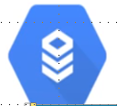
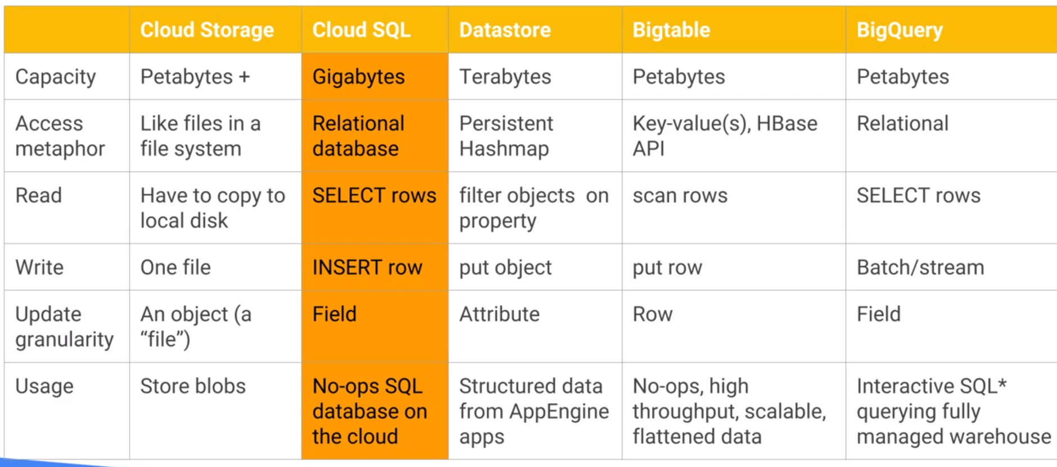
GCP, Step 2, Choose One Solution to Store Data: Cloud SQL, RDB for gigabytes

Slide 21
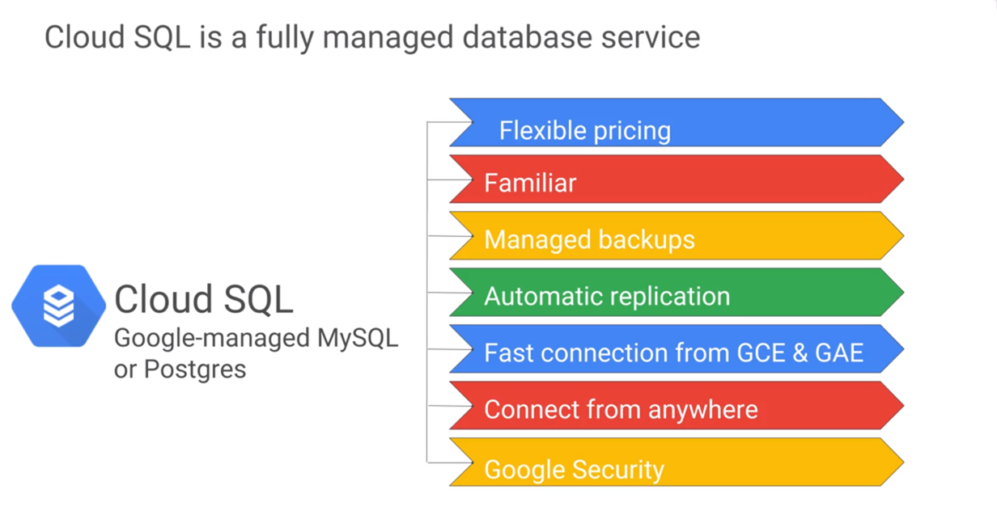
GCP, Step 2, Choose One Solution to Store Data: Cloud SQL , RDB for gigabytes
Relational Database

Slide 22
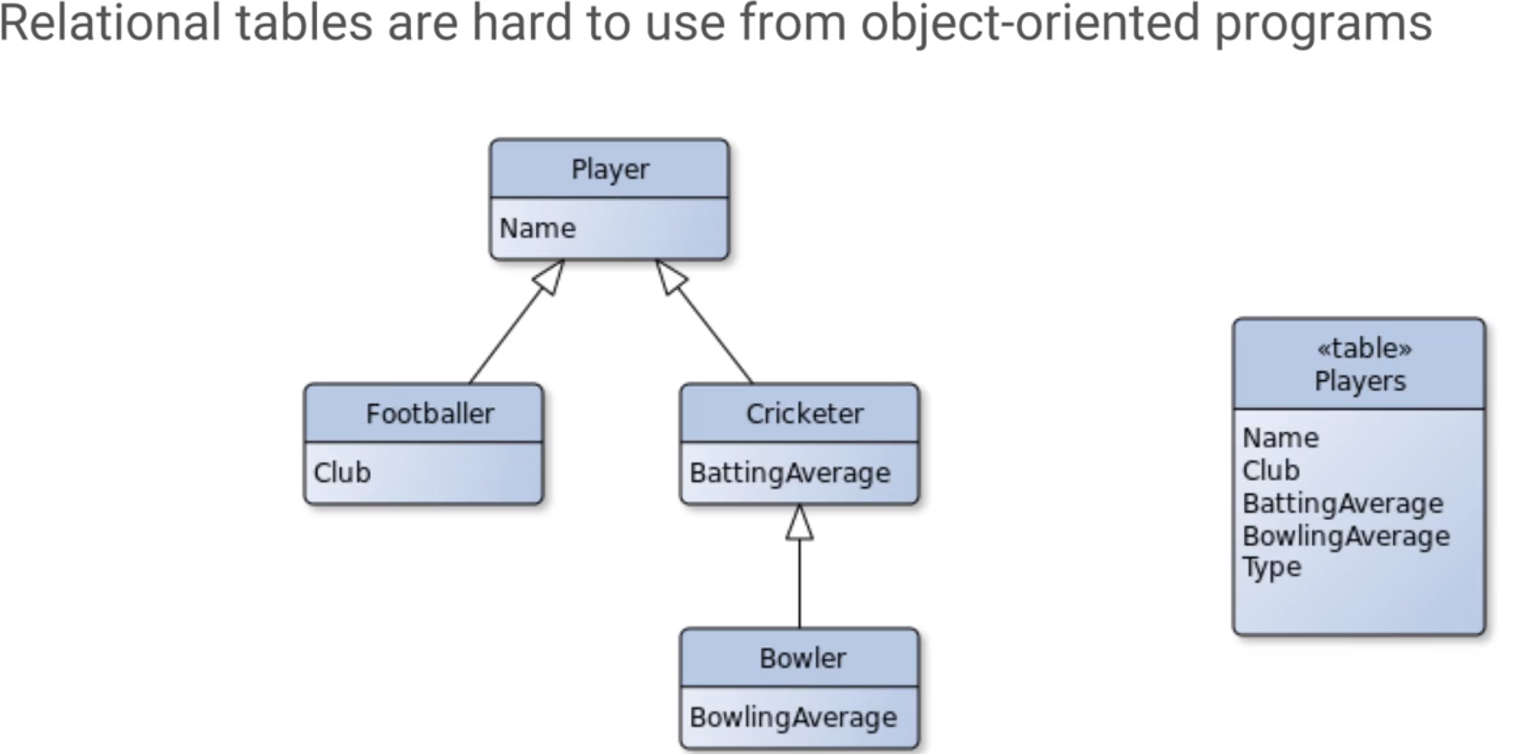
GCP, Step 2, Choose One Solution to Store Data: Cloud SQL , RDB for gigabytes
Use RDB schema to show OO Data, Hierarchical, NULL is needed to fill in the column which leads to data integrity problems

Slide 23
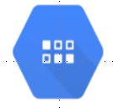
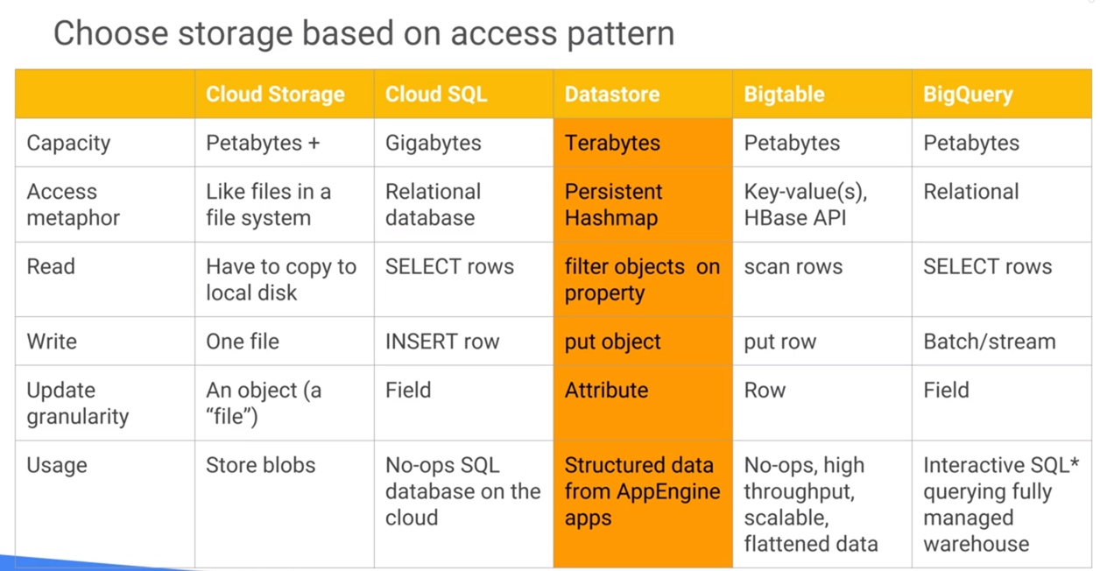
GCP, Step 2, Choose One Solution to Store Data: DataStore, transaction support for Hierarchy data

Slide 24
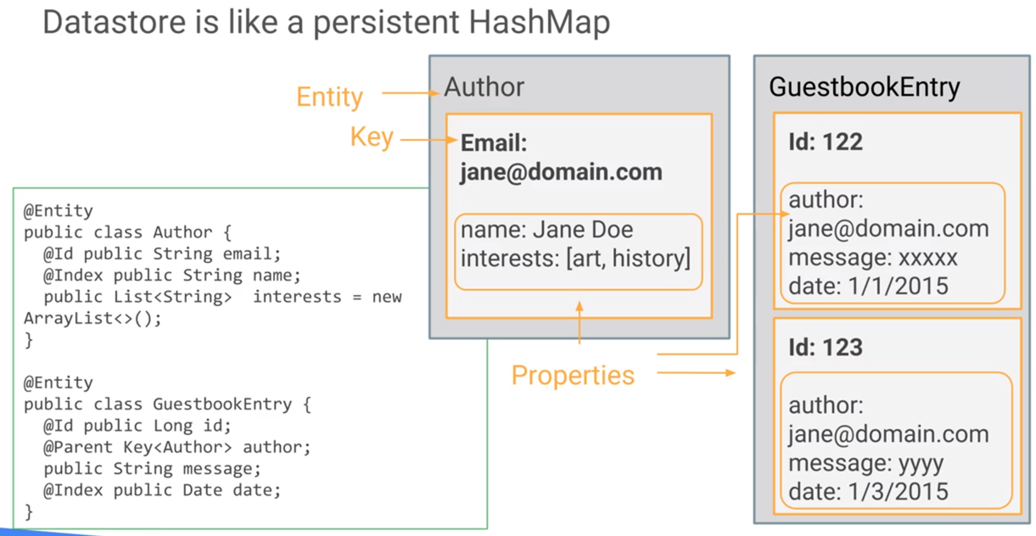
GCP, Step 2, Choose One Solution to Store Data: DataStore, transaction support for Hierarchy data

Slide 25
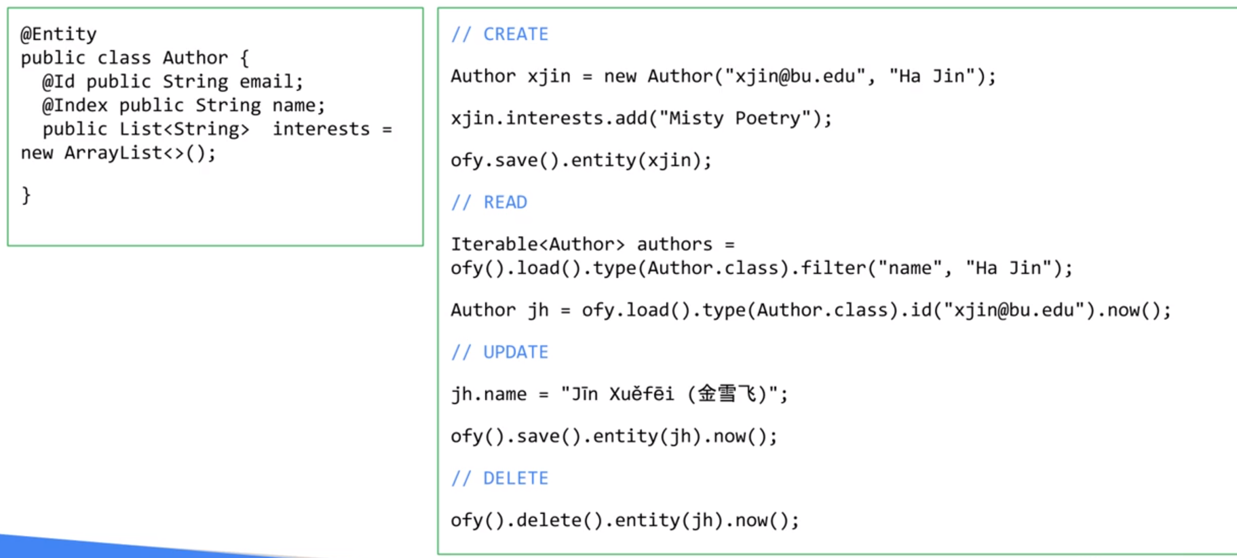
GCP, Step 2, Choose One Solution to Store Data: DataStore, transaction support for Hierarchy data
Memory
Cloud: save it to xx entity
Iterable, since selected data (gigabyte) might too big to save into memory
objectify

Slide 26
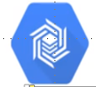
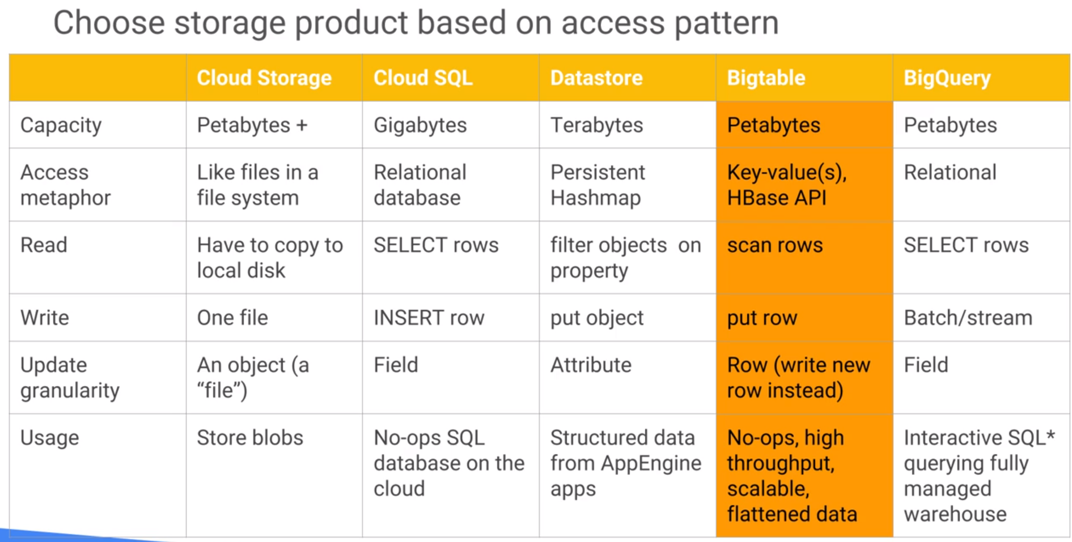
GCP, Step 2, Choose One Solution to Store Data: Bigtable, high throughput need, flatten data 1*N

Slide 27
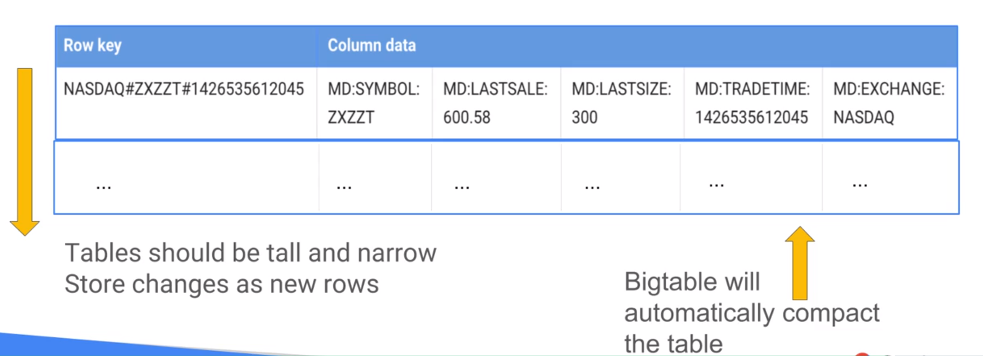
GCP, Step 2, Choose One Solution to Store Data: Bigtable, high throughput need, flatten data 1*N

Slide 28
GCP, Step 2, Choose One Solution to Store Data: Bigtable, high throughput need, flatten data 1*N

Slide 29
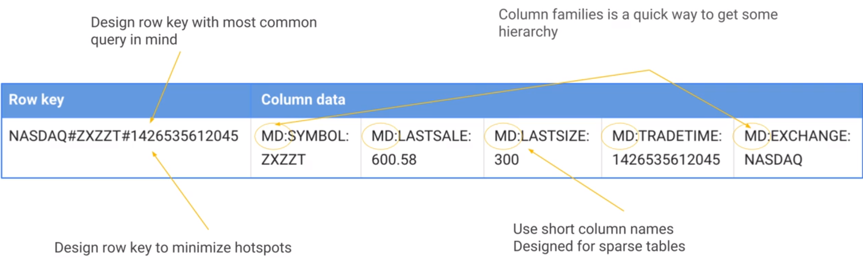
GCP, Step 2, Choose One Solution to Store Data: Bigtable, high throughput need, flatten data 1*N
Marketing Data

Slide 30
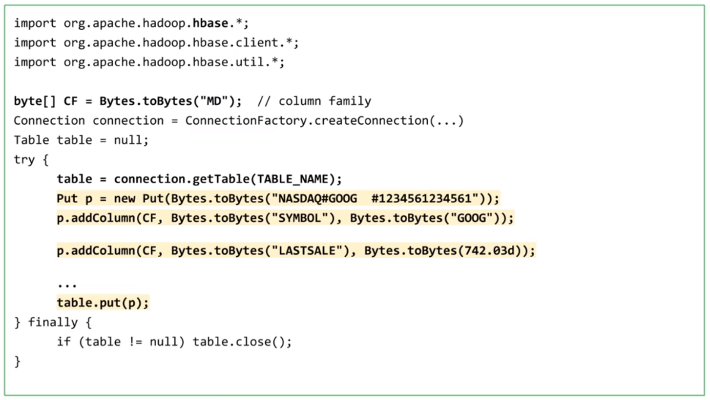
GCP, Step 2, Choose One Solution to Store Data: Bigtable, high throughput need, flatten data 1*N
Marketing Data

Slide 31
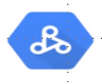
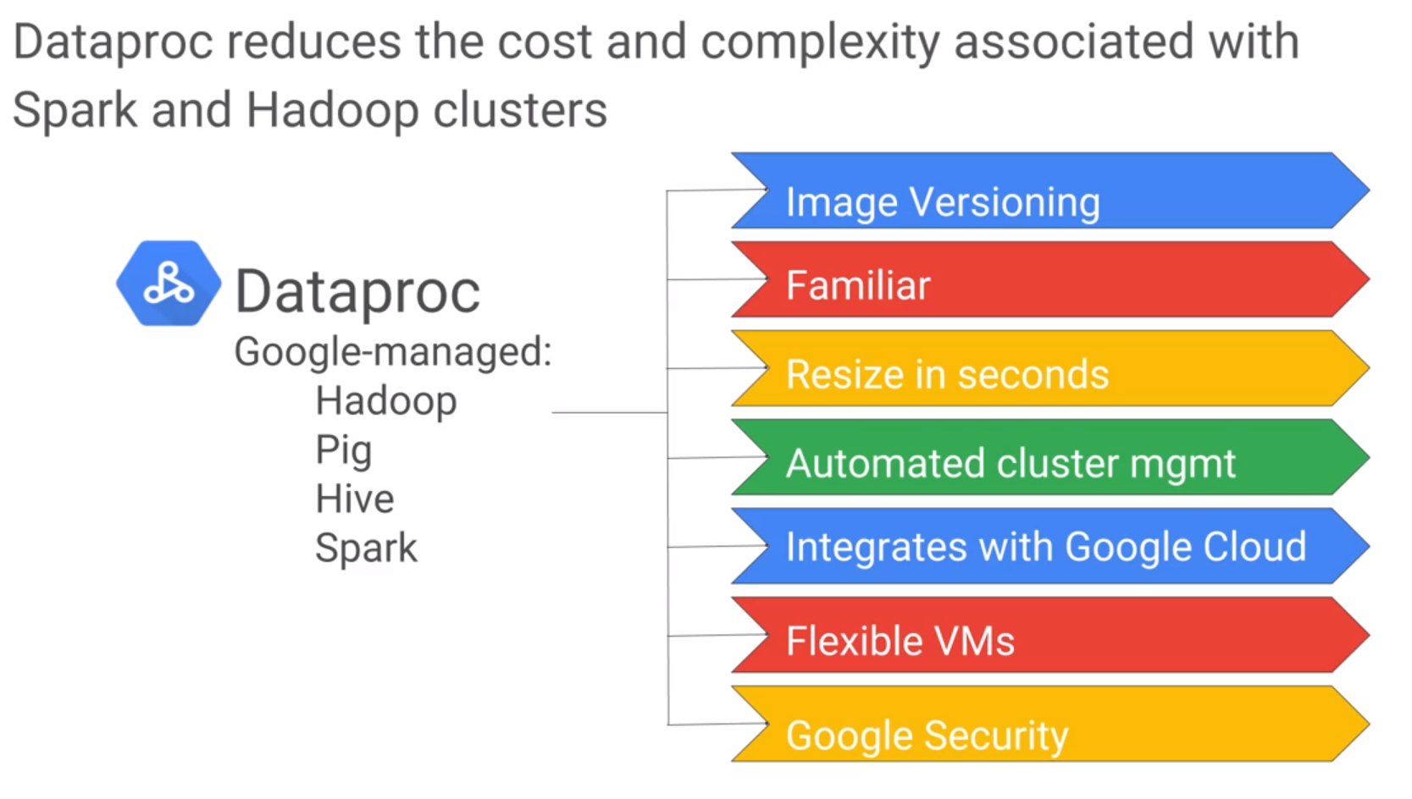
GCP, Step 2, Choose One Solution to Store Data: DataProc
HDFS, cluster need to be UP
Relational Database
Delete cluster will also delete data
U will pay for the compute even u only need storage
Dataproc works well with FVMs, (next VMs)

Slide 32
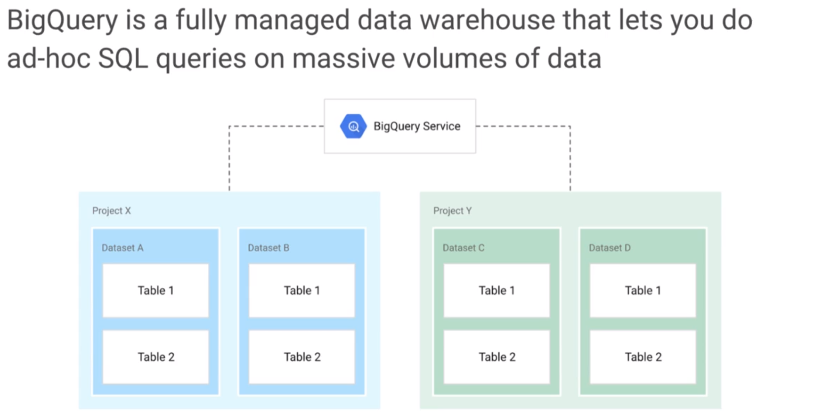
GCP, Step 3, Data Analysis: BigQuery,

Slide 33
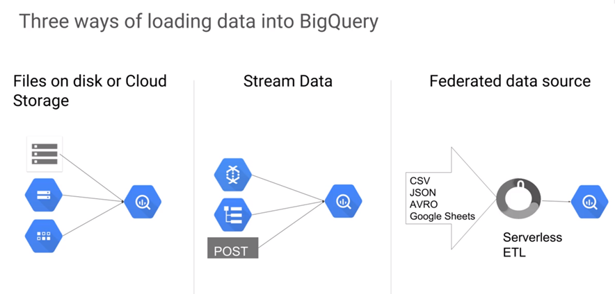
GCP, Step 3, Data Analysis: BigQuery,
Realtime data
Hyperlink
Join other Google Sheets or other data

Slide 34
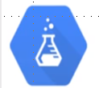
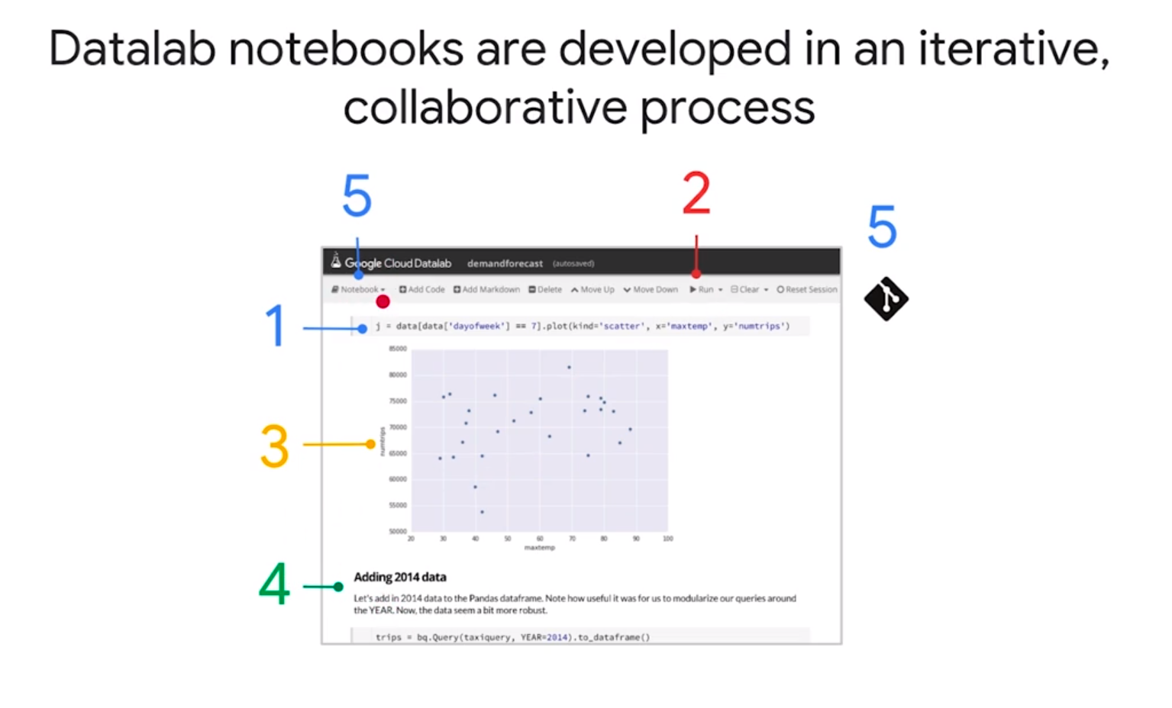
GCP, Step 3, Data Analysis: DataLab

Slide 35
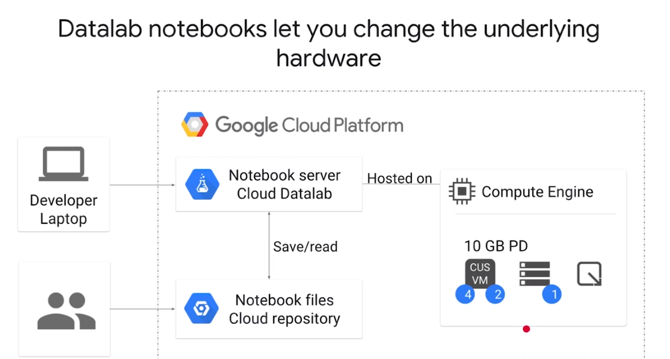
GCP, Step 3, Data Analysis: DataLab
Set u free from hardware limitations

Slide 36
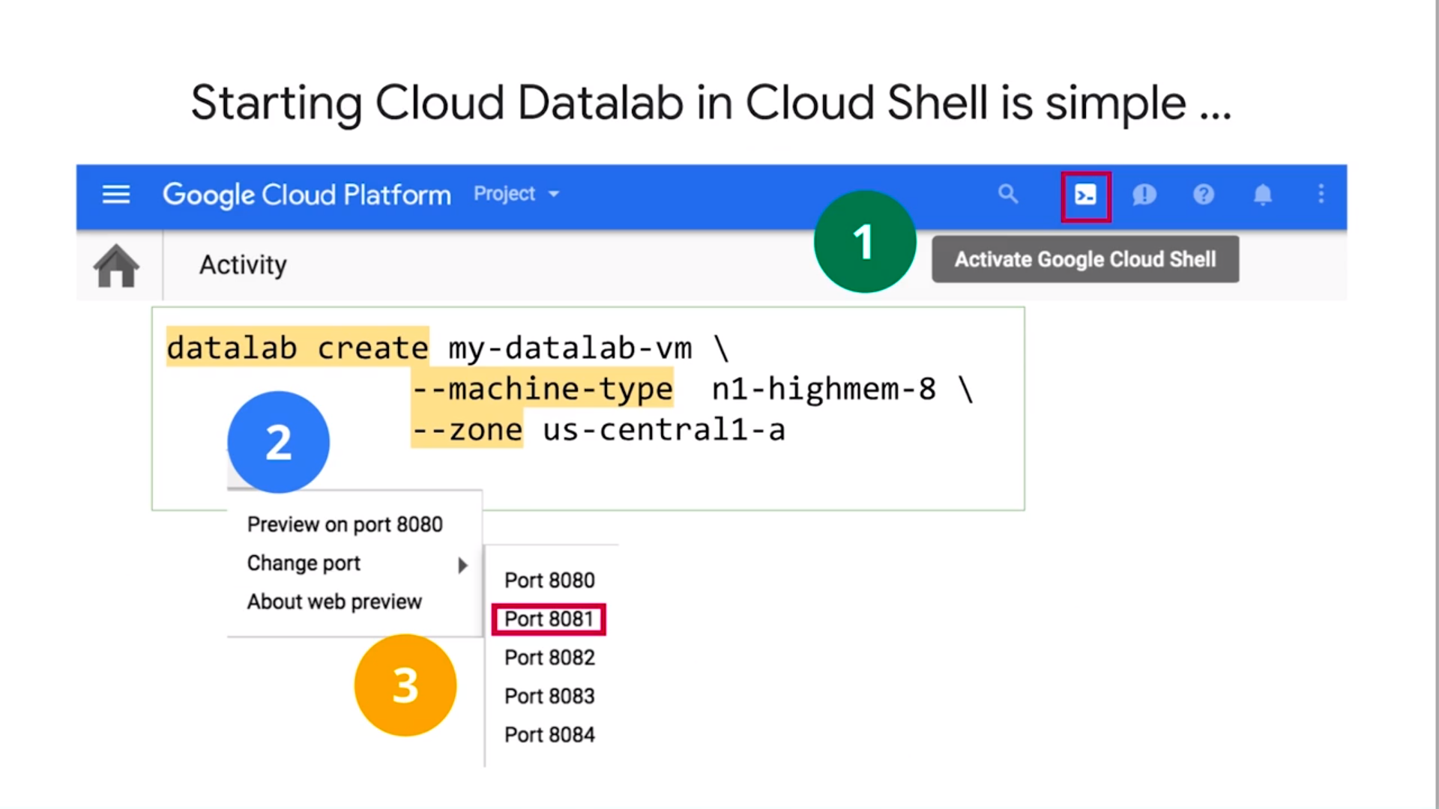
GCP, Step 3, Data Analysis: DataLab
Install GCloud, which can run dataLab on-premiums

Slide 37
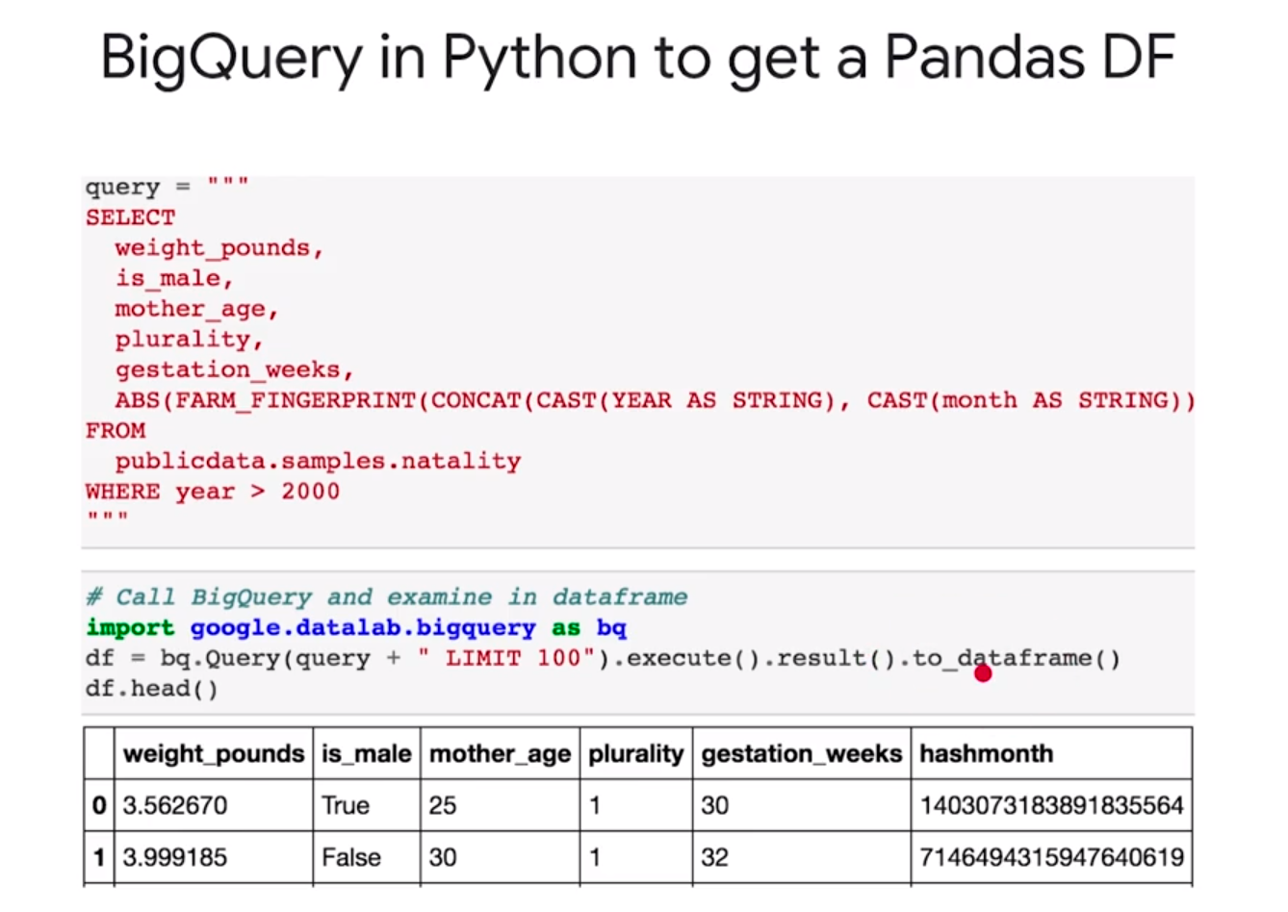
GCP, Step 3, Data Analysis: DataLab

